Slide 1




Mussino.com
A New Music industry, that reaches talented individuals such as you everyday. Our online mission is to connect Millions of Musicians and Artists Leading to more Revenue. Our system is designed and structure similar to emulate the Music industry but on a rapid growing scale for the unsigned talent. A percentage will be split between Musician who create a session and the artist with the most talent & votes.
We know today’s Industry is base on 50% popularity 45% advertisement and leave you with 5% value to express your true talent.

Slide 2
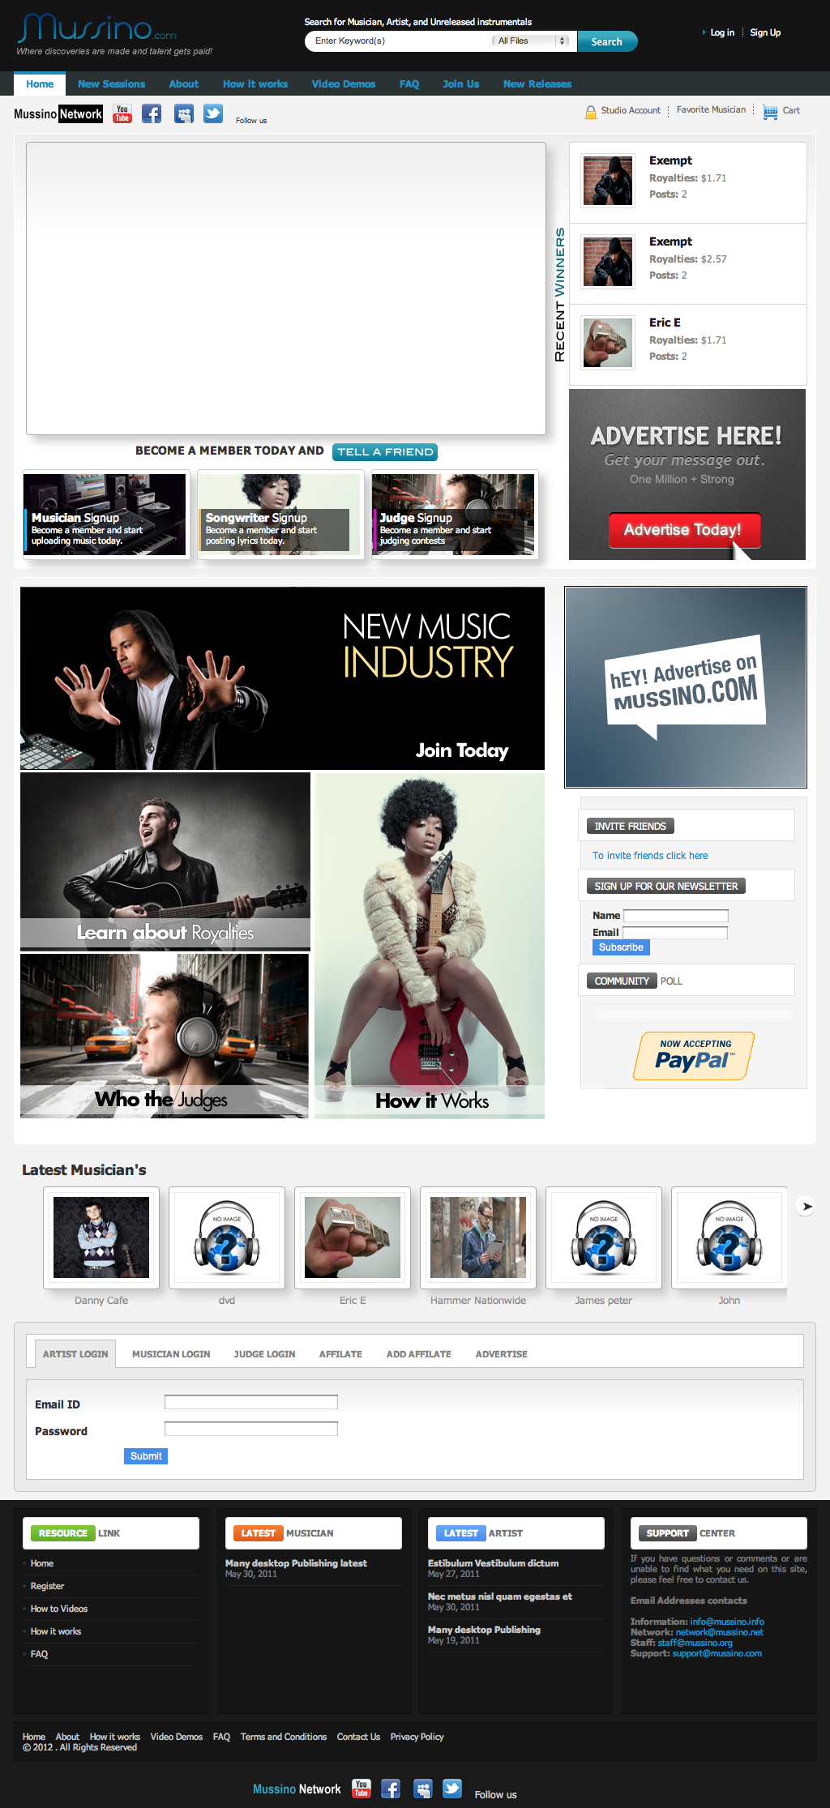
The Concept
Musicians create sessions and Singwriters will
ENTER A SESSION to earn PAID ROYALTIES
Musician create and upload an Instrumental that can last 1 to 7 days
Artists search for Instrumentals; enter a session and post written lyrics, uploaded video, or audio files.
Judges will listen and vote on the most talented artist. Anybody can be a Judge.
The Royalty amount will be divided between the Musician and the artist (songwriter) who has the most votes.

Slide 3
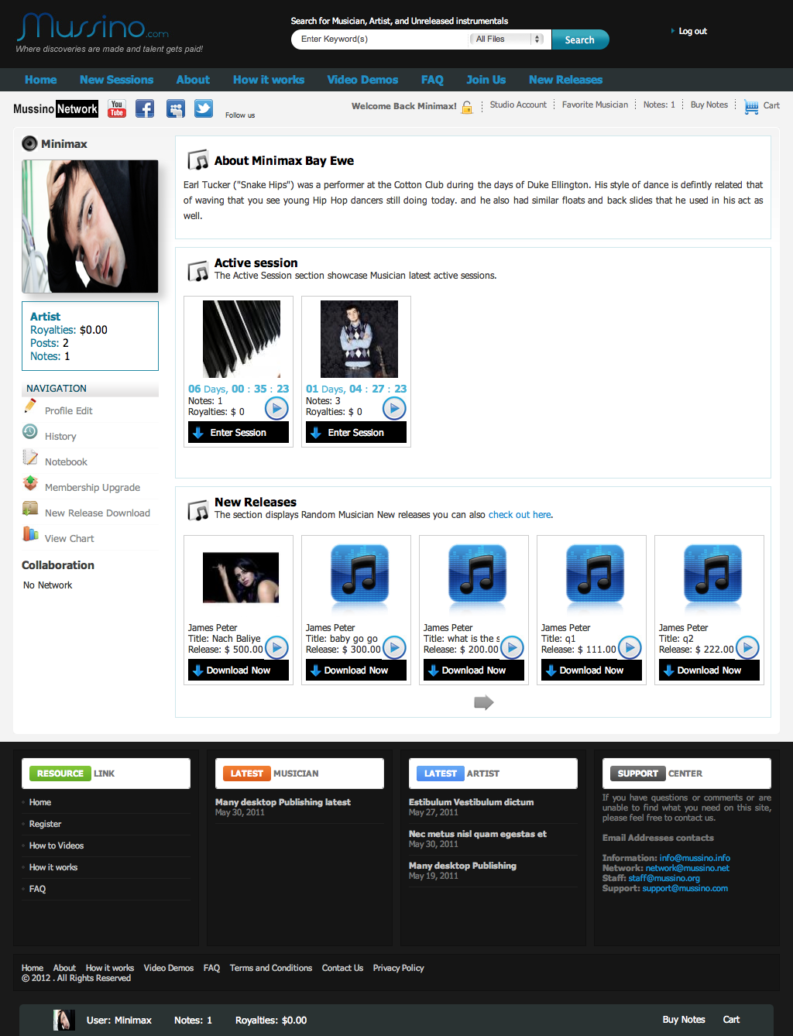
Studio Account
Musician area features
Create New Session
Create Music Store
View Chart
Buy Credits Upgraded
Track Sessions
Earn Royalties
Collabate friend list
Build an album (Coming soon)
Songwriters area features
Enter Session
Sell Music Store (Coming soon)
Build an album (Coming soon)
View Chart
Buy Notes
Track Sessions
Earn Royalties
Collabate friend list
Access audio and video sessions

Slide 4
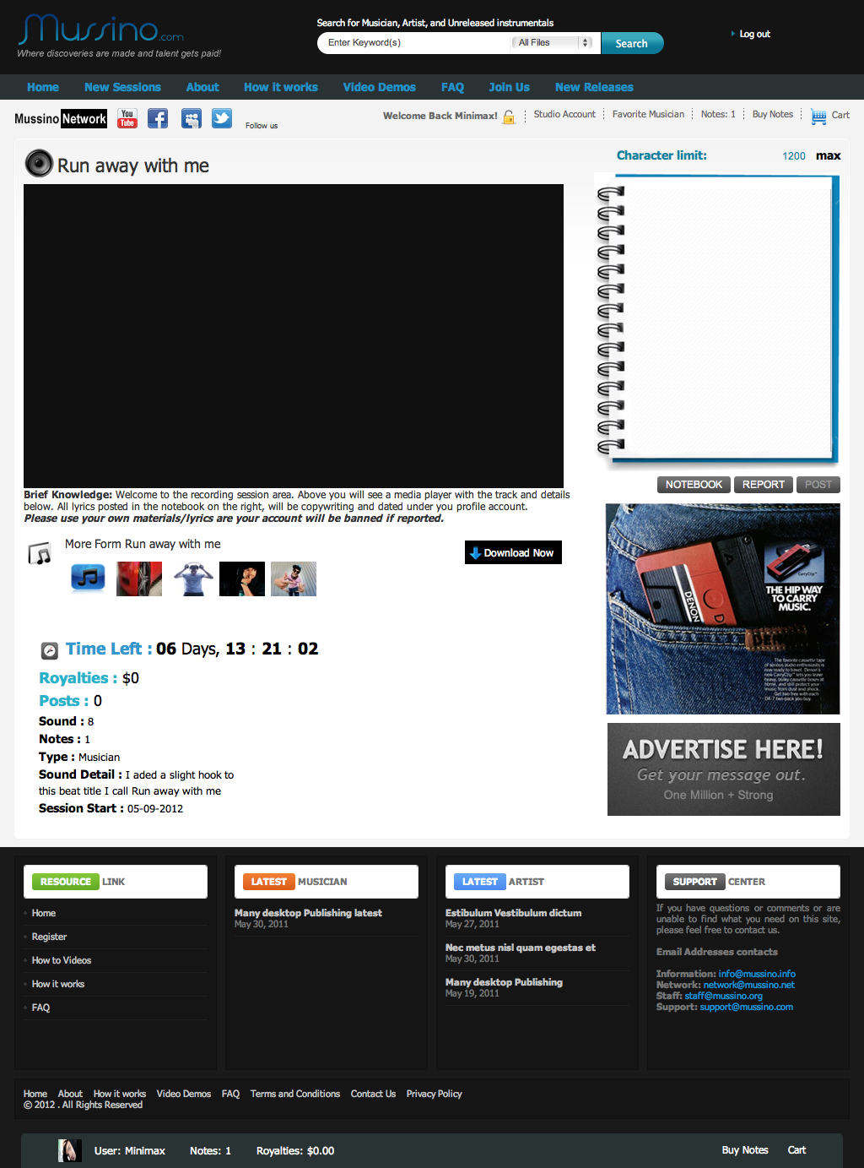
Enter Session
Songwriters will have the option to
Download musician Instrumental file after agreed to terms. Two paid options avialable.
You can upload an Audio file or Video File to highlight your performance.
All session will be Judges together.
Artist (Songwriter) area
Text session free
Audio session (fee)
Video session (fee)

Slide 5
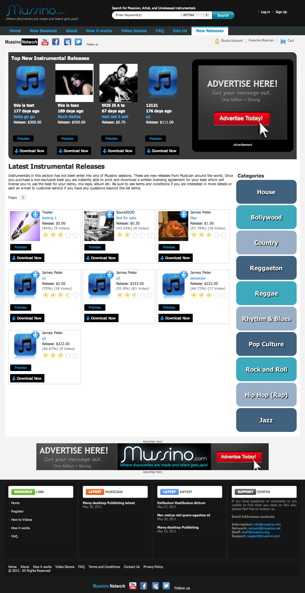
Music Store Options
Musician can sell new Instrumentals
that are not on sessions list.
Artist can sell there album on Mussino
Coming soon.
Build an ablum will allow Songwriter and Musician to work together to create an album on Mussino platform by communicating and networking users
their close session archieve.
Coming soon

Slide 6
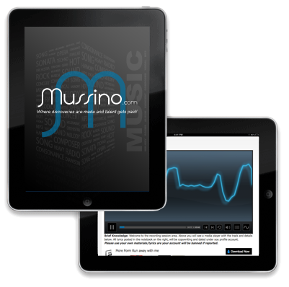
Mobile App
Android Tabs
Ipad
Iphone
The mobile app will have the same concept but custom layout for better user friendly user experience on the desktop. We can also get industry Music companies to sponsors.
Free Trial for non members on the website
Free for members on the website
Mobile user $2.99 to access all features after Free trial.

Slide 7
Age Demographics

Slide 8
Revenue Growth Stage This predication is for 4 months

Slide 9
Revenue Growth Stage This predication is for 2 years

Slide 10
Mussino Revenue
Enter Music Sessions = Notes $1 - $5 (can be increased)
Session Royalties amount 5% of each session earning goes to Admin
Musician Membership = Credits $5.99 - $19.99 a month
Ex: 1000 users x $5.99 = $5,500 a month
Ex: 1000 users x $19.99 = 19,990 a month
Artist Membership = Upload Access $2.99 - $5.99 a month
Ex: 1000 users x $2.99 = $2,990 a month
Ex: 1000 users x $5.99 = $5,500 a month
New Music Releases = $1 - (Musician set price)
Music Sells = $1 - (Artist set price)
Advertisement = starting $50 a month
Mobile sells = 2.99 non members + memberships + sessions

Slide 11
Build an Album
Coming Soon!
Songwriters will collobarate with Musician, sending message and searching
close session archive for material. They have the option to chat on live cam,
send messagers, or search close session. Once they have created an album and submit to Mussino Music Store for publish sells. We will use iTune approch for the unsigned talent market. Developing straight downloads to mobile devices.

Slide 12
The Strategy
Paid Youtube Viewers create Videos about Mussino
Admin manage 50 startup sessions
Admin loses 50 session to pay members (tell a friend)
Email Marketing
Connect with all Instrumental website selling music
Connect with all Music websites to advertise
Media PR
How to videos
Social Networking

Slide 13
Startup Expenses
Needs | Cost
Php Developers | $1,700
Mobile app | $7,000
Advertisement | $3,000
Press | $500
Social media | $100
Ad words & SEO | $500
Estimate | $12,800 6 months after $25,000

Slide 14
Premium Expenses
Needs | Cost
Php Developers | $5,000
Mobile app | $10,000
Advertisement | $25,000
Press | $10,000
Social media | $250
Ad words & SEO | $10,000
Estimate | $60,250+ 6 months after $120,000

Slide 15
Empire Overview 2015

